Slide 1
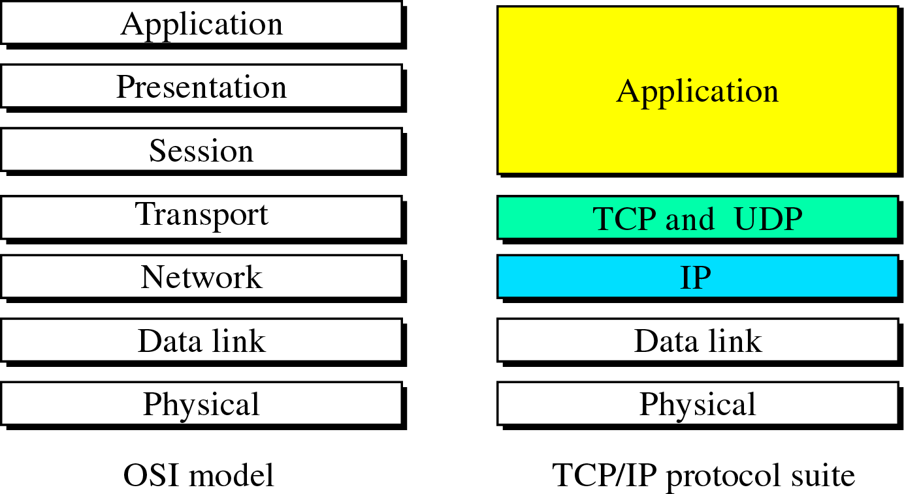
Application Layer
Because the TCP/IP protocol suite was designed before the OSI model, the layers in TCP/IP do not correspond exactly to the OSI layer.

Slide 2
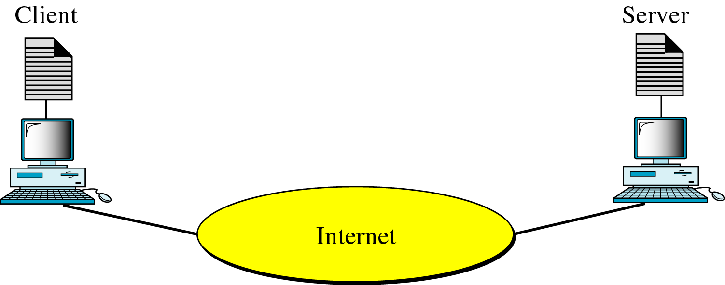
Client-sever model
To use the service available on an internet, application programs, running at two end computers and communicating with each other, are needed.
In other words, in an internet, the application programs are the entities that communicate with each other, not the computers or the users.
The application programs using the internet follow the client-server model strategies.

Slide 3
Cont.
A client is a program running on the local machine requesting service from a server. A client program is finite, which means it is started by the user (or another application program) and terminates when the service is complete.
A server is a program running on the remote machine providing service to the clients. A server program is an infinite program. When it starts , it runs infinitely unless a problem arises. It waits for incoming requests from the clients. When a request arrives, it responds to the request.

Slide 4
BOOTSTRAP PROTOCOL (BOOTP)
Each computer that is attached to a TCP/IP internet must know the following:
Its IP address
Its subnet mask
The IP address of a router
The IP address of a name server
This information is usually stored in a configuration file and accesses by the computer during the bootstrap process. But what about a diskless workstation or a computer with a disk that is booted for the first time?

Slide 5
Cont.
In the case of a diskless computer (A diskless workstation or PC on a local-area network (LAN) is a computer system that does not have its own disk. Instead, it stores files on a network file server.), the operating system and the networking software could be stored in ROM. However, the above information is not known to the manufacturer and thus cannot be stored in ROM.

Slide 6
Cont.
The information is dependent on the individual configuration of the machine and relates to the network to which the machine is connected. Bootstrap protocol (BOOTP) is a client-server protocol designed to provide the four previously mentioned pieces of information for a computer that is booted for the first time.

Slide 7
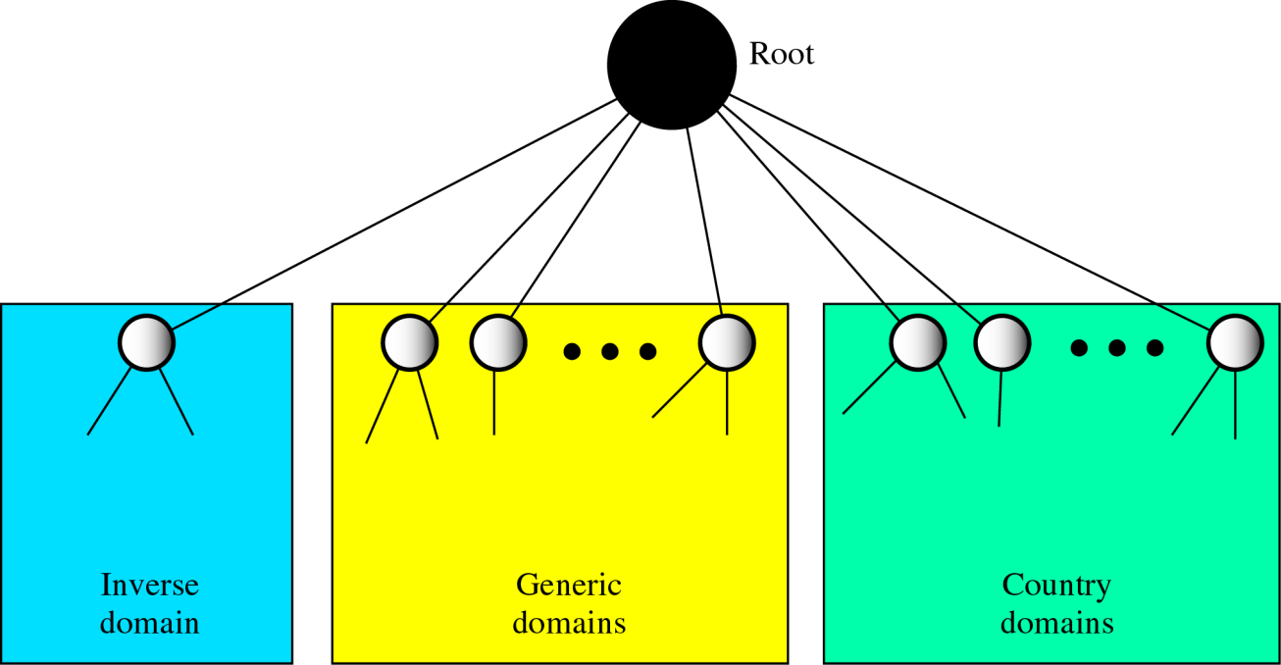
Domain Name System
To identify an entity, TCP/IP protocols use the IP address, which uniquely identifies the connection of a host to the Internet. However, people prefer to use names instead of addresses. Therefore, we need a system that can map a name to an address and conversely an address to a name. In TCP/IP, this is the Domain Name System (DNS). In the internet, the domain name space is divided into three different section:

Slide 8
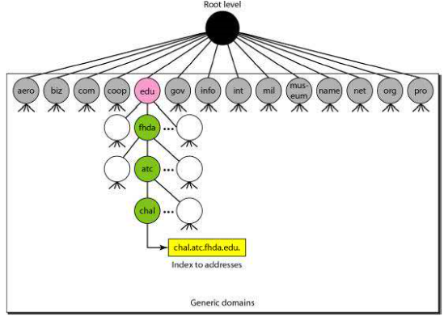
Generic Domains
The generic domains define registered hosts according to their generic behaviour. Each node in the tree defines a domain, which is an index to the domain name space database. Looking at the tree, we see that the first level in the generic domains section allows 14 possible labels(4 bits).

Slide 9
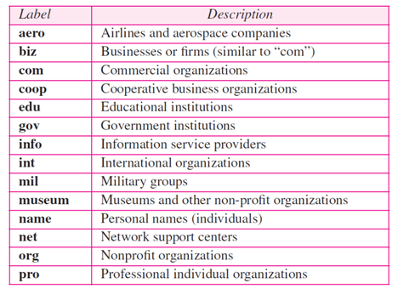
Generic Domain Labels

Slide 10
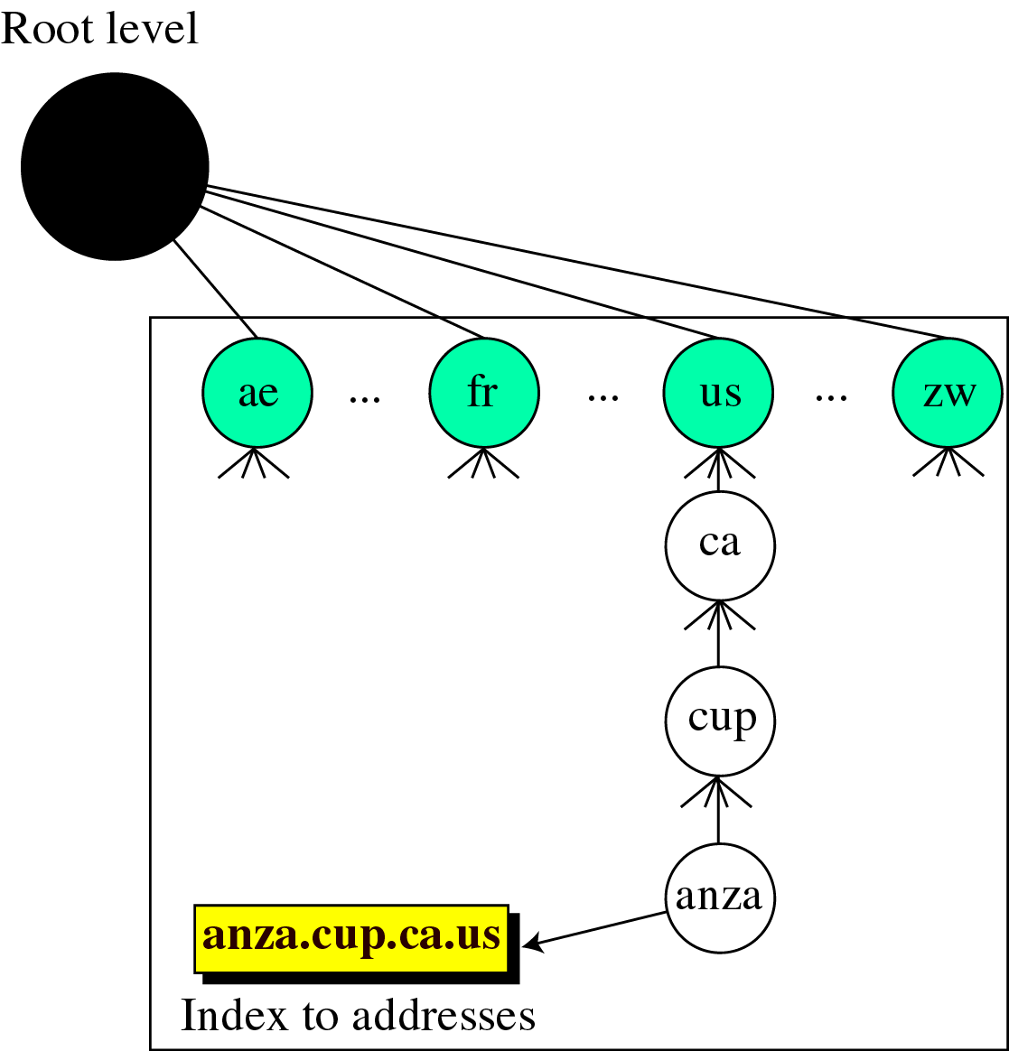
Country Domain
The country domains section uses two-character country abbreviations (e.g., us for United States). Second labels can be organizational, or they can be more specific, national designations. The United States, for example, uses state abbreviations as a subdivision of us (e.g., ca.us.). The address anza.cup.ca.us can be translated to De Anza College in Cupertino, California, in the United States.

Slide 11
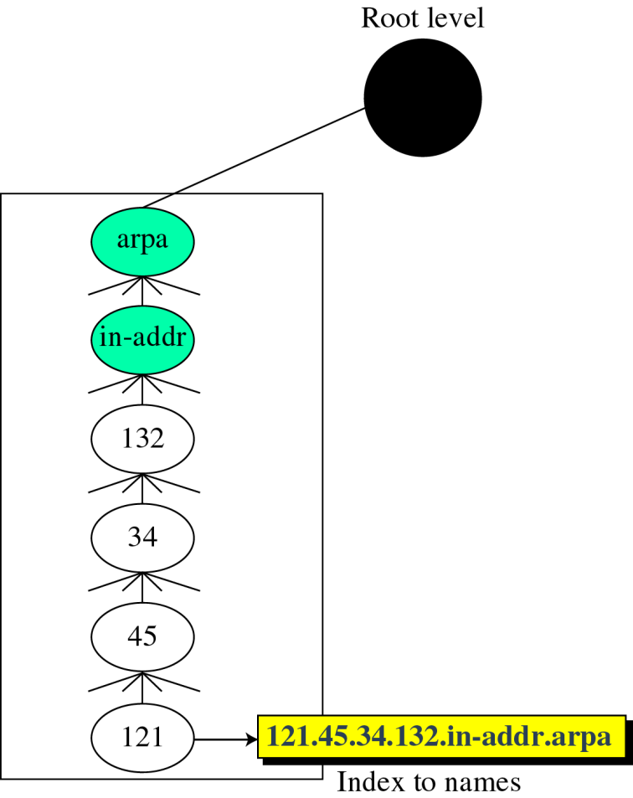
Inverse Domain
The inverse domain is used to map an IP address to a name. This may happen, for example, when a server has received a request from a client to do a task.
The inverse domain is added to the domain name space with the first-level node called arpa (for historical reasons).
The second level is also one single node named in-addr (for inverse address).
The rest of the domain defines IP addresses.

Slide 12
TELNET
TELNET is a general-purpose client-server program that lets a user access any application program on a remote computer; in other words, it allows the user to log onto a remote computer. After logging on, a user can use the services available on the remote computer and transfer the results back to the local computer.
TELNET is an abbreviation for terminal network. TELNET enables the establishment of a connection to a remote system in such a way that the local terminal appears to be a terminal at the remote system.
In local log-in, the user terminal is directly connected to the target computer; in remote log-in, the user computer is connected to the target computer through the Internet."

Slide 13
The TELNET Protocol
The Telnet client program performs two important functions - interacting with the user terminal on the local host and exchanging messages with the Telnet server. The client connects to port 23 on the remote machine, which is the port number reserved for Telnet servers. The TCP connection persists for the duration of the login session. The client and the server maintain the connection, even when the user interrupts the transfer of data, for example by hitting cntl-C.

Slide 14
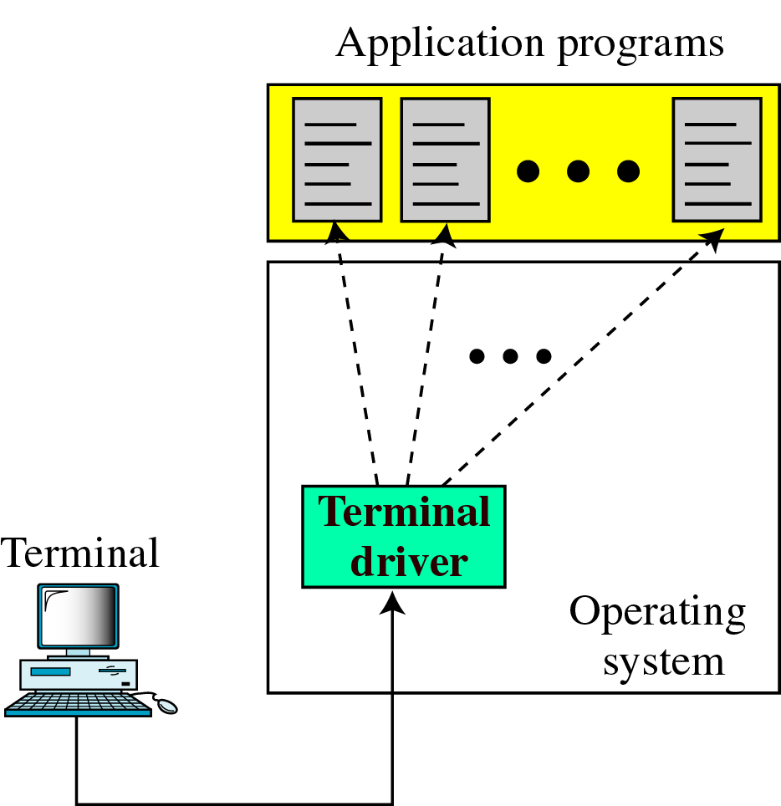
Local Login
When a user logs onto a local time-sharing system, it is called local
login. As a user types at a terminal or at a workstation running a terminal emulator, the keystrokes are accepted by the terminal driver. The terminal driver passes the characters to the operating system. The operating system, in turn, interprets the combination of characters and invokes the desired application program.

Slide 15
Cont.
The mechanism, however, is not as simple as it seems because the operating system may assign special meanings to special characters. For example, in UNIX some combinations of characters have special meanings, such as the combination of the control character with the character z means suspend; the combination of the control character with the character c means abort; and so on. Whereas these special situations do not create any problem in local login because the terminal emulator and the terminal driver know the exact meaning of each character or combination of characters, but they may create problems
in remote login.

Slide 16
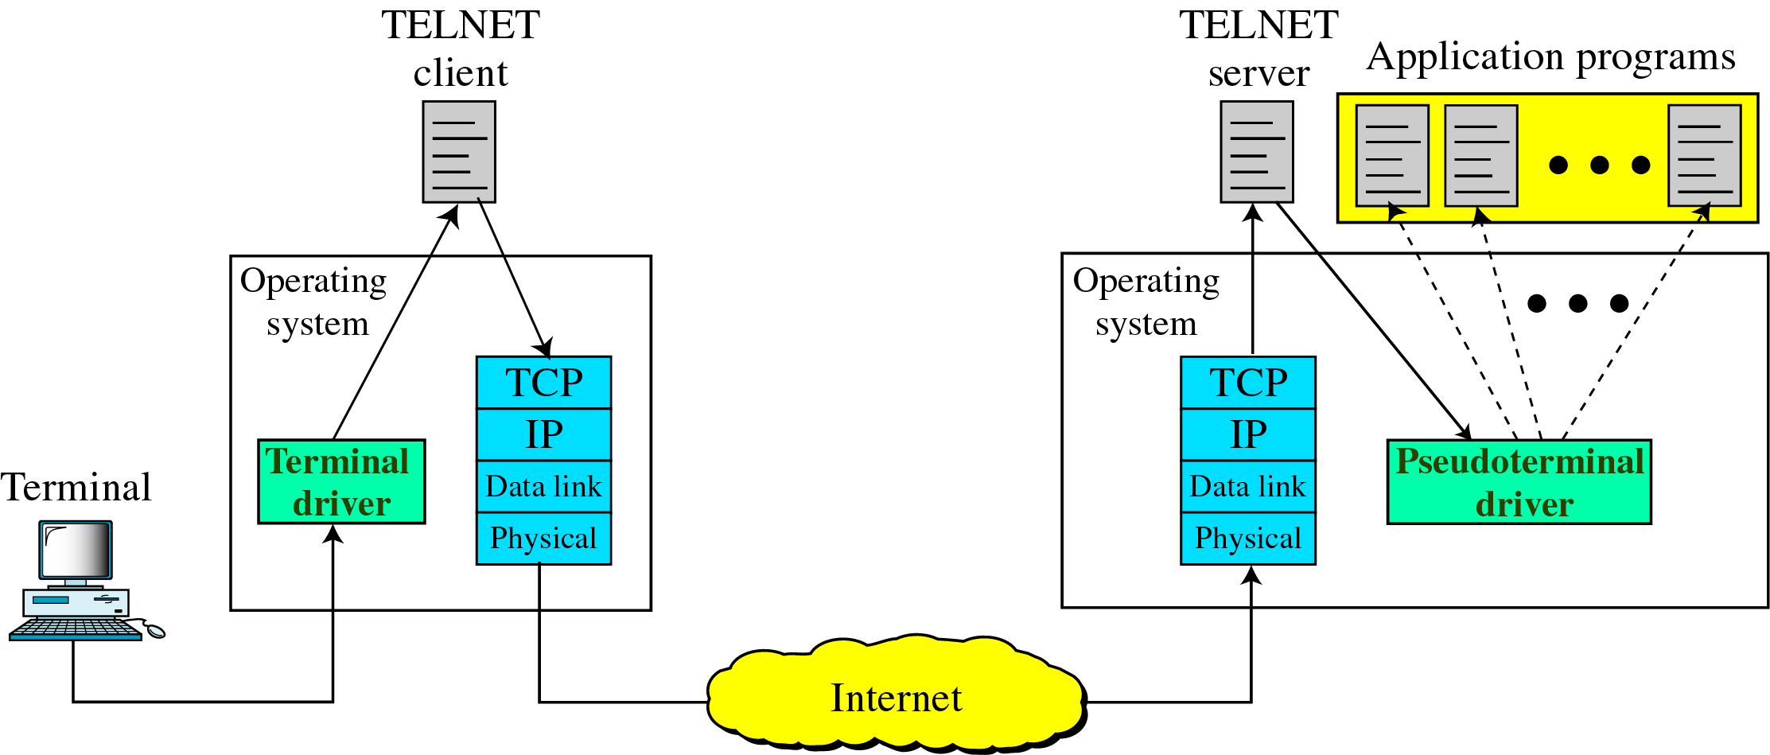
Remote Login
When a user wants to access an application program or utility located on a remote machine, he or she performs remote login. Here the TELNET client and server programs come into use. The user sends the keystrokes to the terminal driver where the local operating system accepts the characters but does not interpret them.

Slide 17
Remote Login
The characters are sent to the TELNET client, which transforms the characters to a universal character set called network virtual terminal characters and delivers them to the local TCP/IP stack

Slide 18
FTP
FTP (File Transfer Protocol) is a network protocol for transmitting files between computers over Transmission Control Protocol/Internet Protocol (TCP/IP) connections. Within the TCP/IP suite, FTP is considered an application layer protocol.
In an FTP transaction, the end user's computer is typically called the local host. The second computer involved in FTP is a remote host, which is usually a server. Both computers need to be connected via a network and configured properly to transfer files via FTP. Servers must be set up to run FTP services, and the client must have FTP software installed to access these services.

Slide 19
Cont.
Although many file transfers can be conducted using Hypertext Transfer Protocol (HTTP) -- another protocol in the TCP/IP suite -- FTP is still commonly used to transfer files behind the scenes for other applications, such as banking services. It is also sometimes used to download new applications via web browsers.FTP allows a user to copy files to and from a remote machine. The client program also sends commands to the server program to coordinate the copying of files between the two machines on behalf of the user. FTP has a command channel for controlling the conversation and a data channel for transmitting file content. A data Port 20 is used for data connection.

Slide 20
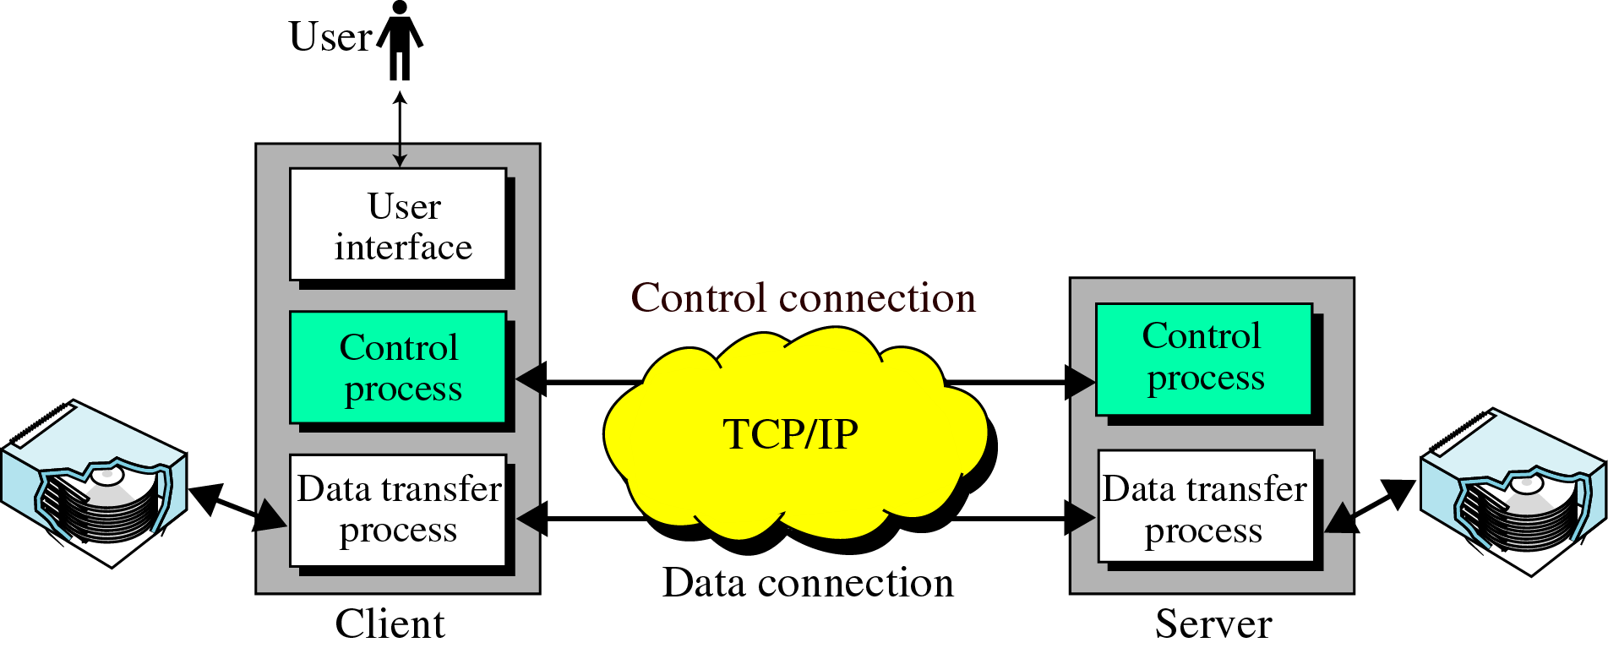
Basic model of FTP
Figure shows the basic model of FTP. The client has three components: the user interface, the client control process, and the client data transfer process. The server has two components: the server control process and the server data transfer process. The control connection is made between the control processes. The data connection is made between the data transfer processes.

Slide 21
Simple Mail Transfer Protocol (SMTP)
One of the most popular network services is electronic mail (e-mail).
The TCP/IP protocol that supports electronic mail on the Internet is called SMTP.
SMTP supports:
Sending a single message to one or more recipients.
Sending messages that include text, voice, video or graphics.
Sending messages to users on networks outside the Internet.

Slide 22
Cont.
Both SMTP server and SMTP client can be divided into two components: user agent (UA) and mail transfer agent (MTA).
The user agent prepares the message, creates the envelope, and puts the message in the envelope.
The MTA transfers the message in the internet.

Slide 23
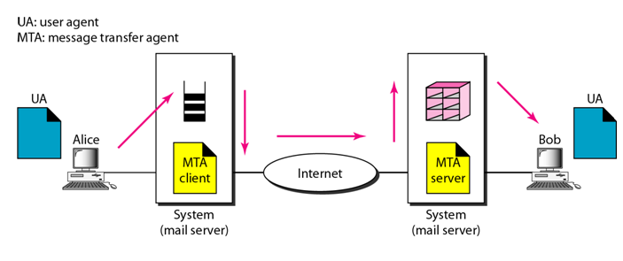
Cont.

Slide 24
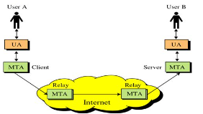
Cont.
SMTP protocol allows a more complex system.
Relaying could be involved. Instead of just one MTA at the sender site and one at the receiver site, other MTAs, acting either as client or server, can relay the mail.

Slide 25
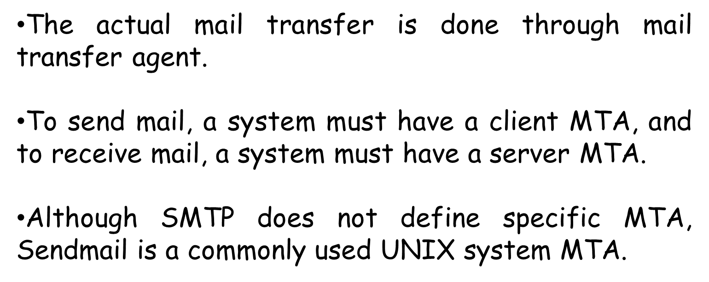
USER AGENT
The user agent is normally a program used to send and receive mail.

Slide 26
End

